Slide 1
Pemrograman Berbasis Obyek
PL1AB

Slide 2
Inheritance

Slide 3
Konsep utama OOP
Encapsulation (pembungkusan)
Inheritance (pewarisan)
Polymorphism

Slide 4
Inheritance
A mechanism to design two or more different entities which share many common features
The ability of a class to inherit the attributes and methods of another class.
Penciptaan kelas baru dengan mewarisi karakteristik kelas yang telah ada, ditambah karakteristik unik kelas baru
Sub kelas mewarisi semua metode dan variabel dari superkelas
Jika sebuah metode sudah didefinisikan di superkelas, metode tersebut tidak harus didefinisikan ulang di subclass

Slide 5
What’s the issue
Dog has an eye color, fur color, breed, bark frequency and the ability to bark
Cat has an eye color, fur color, breed, meow frequency and the ability to meow
How do you design the classes?

Slide 6
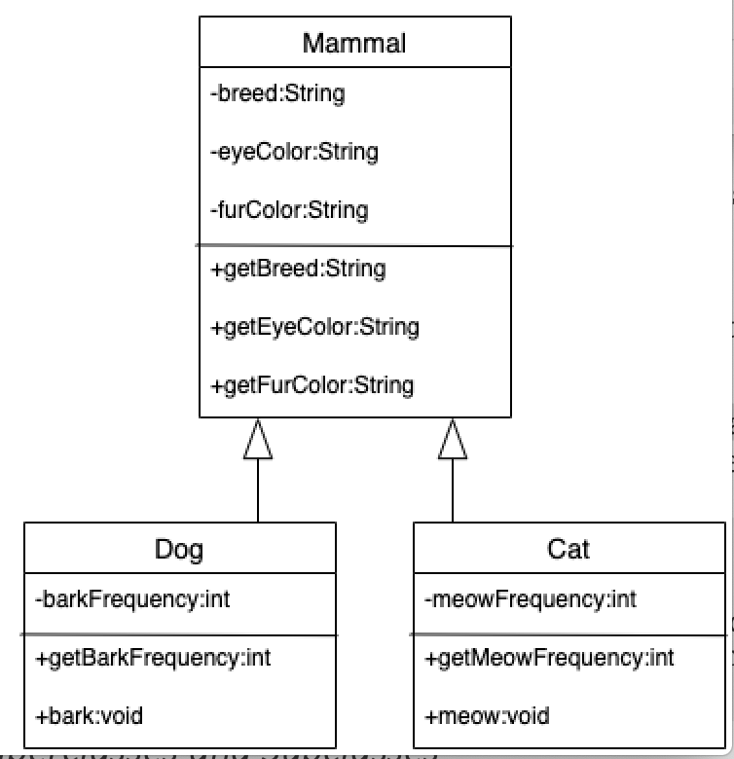
Solution : Dog & Cat
When the Dog or the Cat object is instantiated, it contains everything in its own class, as well as everything from the parent class.

Slide 7
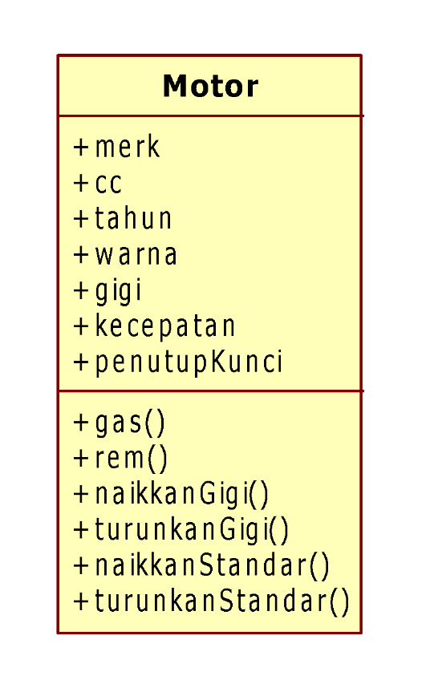
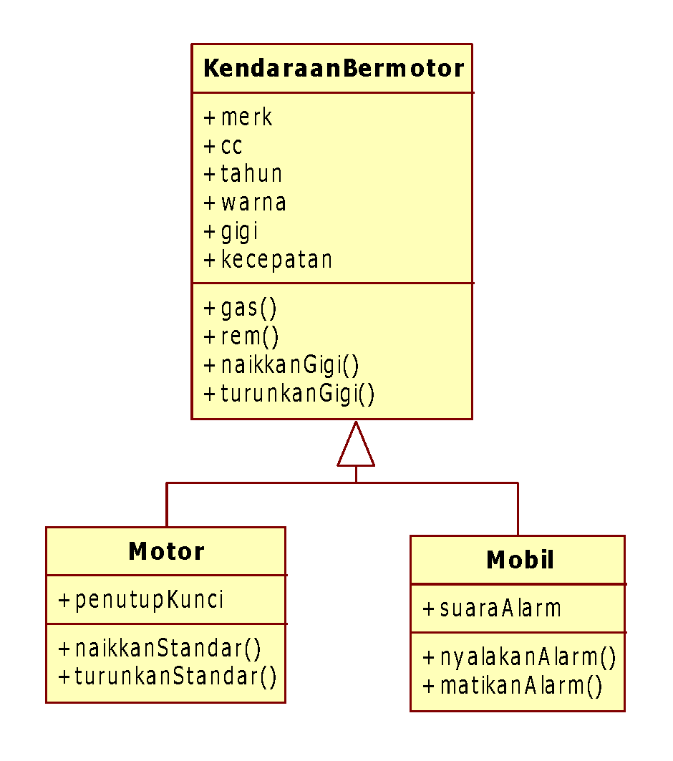
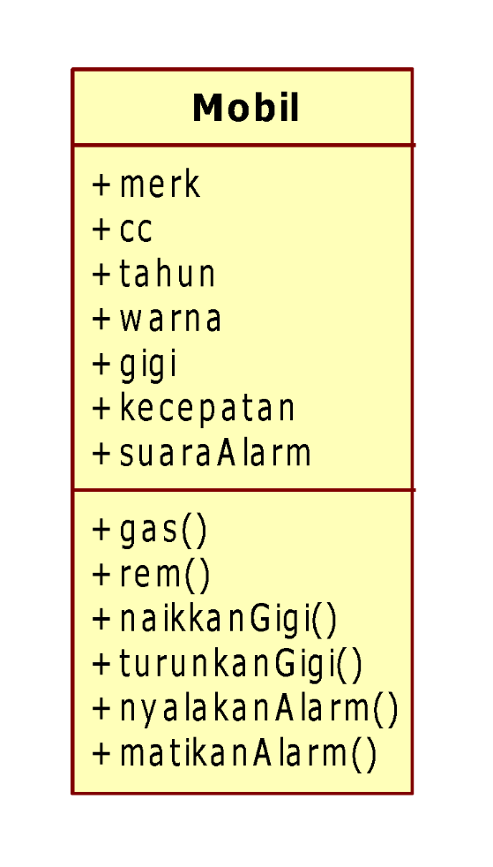
Dengan konsep Inheritance, maka menjadi :

Slide 8
What’s the issue
Motorcycle
Attributes
model
year
color
speed
Methods
onStart()
onBrake()
onStop()
honk()
turnLeft()
turnRight()
moveForward
moveBackward()
putDownKickstand()
putUpKickstand()

Slide 9
What’s the issue
Car
Methods
onStart()
onBrake()
onStop()
honk()
turnLeft()
turnRight()
moveForward
moveBackward()
startWiper()
stopWiper()
Attributes
model
year
color
speed

Slide 10
What’s the issue
Car
Motorcycle
Methods
onStart()
onBrake()
onStop()
honk()
turnLeft()
turnRight()
moveForward
moveBackward()
startWiper()
stopWiper()
Methods
onStart()
onBrake()
onStop()
honk()
turnLeft()
turnRight()
moveForward
putDownKickstand()
putUpKickstand()

Slide 11
Solution for Car & Motorcycle ?

Slide 12
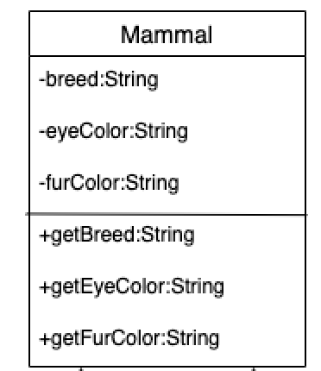
Superclass/parent class
Contains all the attributes and behaviors that are common to classes that inherit from it.

Slide 13
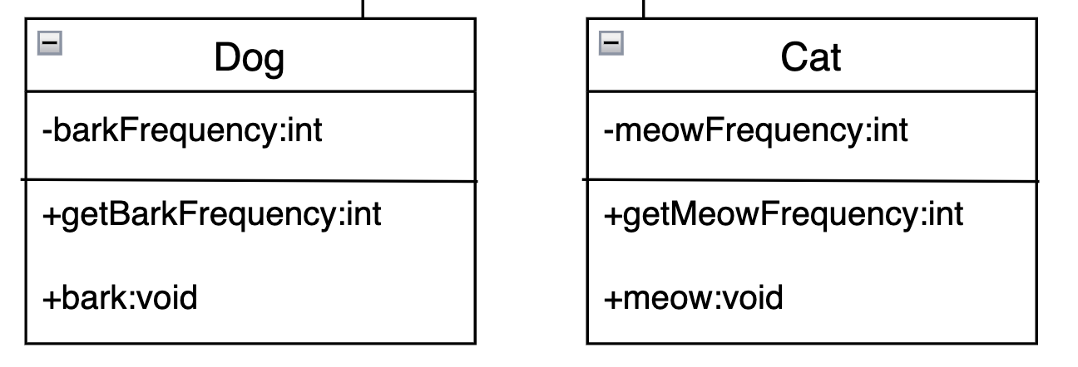
Subclass/child class
An extension of the superclass.
It inherits those common attributes and behaviors from the parent

Slide 14
Implementation
class Mammal {
…
}
class Dog extends Mammal {
…
}
class Cat extends Mammal {
…
}

Slide 15
Assignment
You have several rooms that can be rented out. Each room has a room number, price, length and width of the room.
The rooms for rent consist of 2 types, namely regular and special rooms. The special room provides a toilet inside the room and a car park. While the regular room only provides a space to park a bike.
Please think about the encapsulation & hierarchy of the classes to identify the classes, attributes & methods.
Then draw the class diagram !

Slide 16
Reference
Baesens, Bart, Backiel, Aimee, vanden Broucke, Seppe. Beginning Java Programming: The Object-Oriented Approach. 2015
Danny Poo, Derek Kiong and Swarnalatha Ashok. Object-Oriented Programming and Java, 2nd Ed. Springer. 2007.
Kendal Simon. Object Oriented Programming using Java. Ventus Publishing. 2009
Matt Weisfeld . Object-Oriented Thought Process, 5th Edition. 2019.

Slide 17
Thank you ☺ Any Question ?

